Slide 1
Chapter 5
Internal Memory

Slide 2
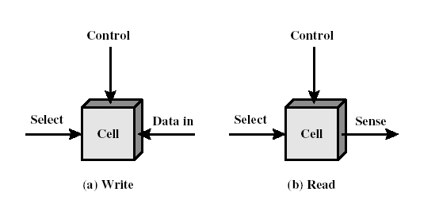
Memory Cell
Basic element – memory cell
  Exhibit 2 stable states used to represent 0 and 1
  Can be written into (at least once)
  Can be read to sense state

Slide 3
Ferrite Core Memory
Before semiconductor memory: core memory
  Magnetic core, 1 core = 1 bit
  Destructive read
  Obsolete
Exerted from Wikipedia

Slide 4
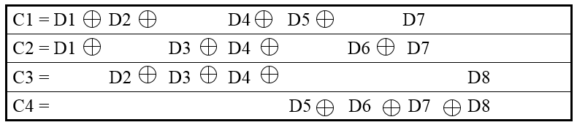
Example
D8
D1
Input word: 00111001
Databit D1 in rightmost position
Calculate check bits:
C1 = 1 ⊕ 0 ⊕ 1 ⊕ 1 ⊕ 0 = 1
C2 = 1 ⊕ 0 ⊕ 1 ⊕ 1 ⊕ 0 = 1
C3 = 0 ⊕ 0 ⊕ 1 ⊕ 0 = 1
C4 = 1 ⊕ 1 ⊕ 0 ⊕ 0 = 0
Stored word = 001101001111
If data bit 3 sustains an error (001101101111)
C1 = 1 ⊕ 0 ⊕ 1 ⊕ 1 ⊕ 0 = 1
C2 = 1 ⊕ 1 ⊕ 1 ⊕ 1 ⊕ 0 = 0
C3 = 0 ⊕ 1 ⊕ 1 ⊕ 0 = 0
C4 = 1 ⊕ 1 ⊕ 0 ⊕ 0 = 0
Calculate syndrome word:
0110 = bit position 6.
D3 resides in bit position 6.
 | C4 | C3 | C2 | C1
 | 0 | 1 | 1 | 1
 | 0 | 0 | 0 | 1
 | 0 | 1 | 1 | 0

Slide 5
DRAM Operation
Address line active when bit read or written
  Transistor switch closed (current flows)
Write
  Voltage to bit line
    High for 1 low for 0
  Then signal address line
    Transfers charge to capacitor
Read
  Address line selected
    transistor turns on
  Charge from capacitor fed via bit line to sense amplifier
    Compares with reference value to determine 0 or 1
  Capacitor charge must be restored

Slide 6
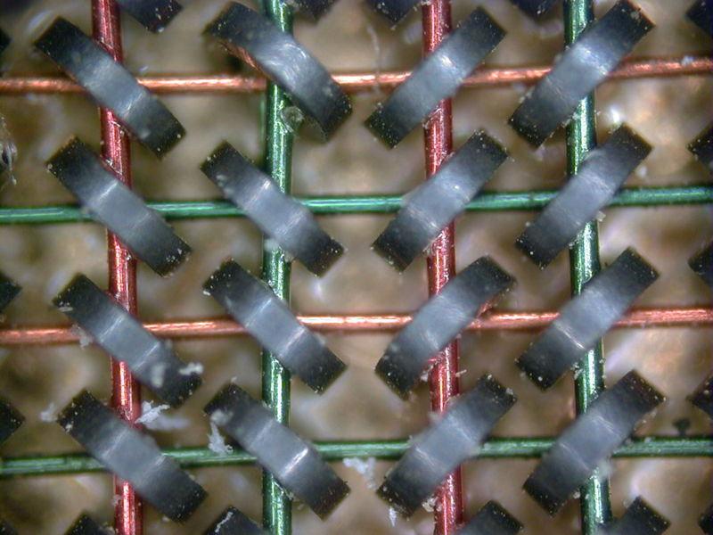
Ferrite Core Memory
Principle
  The major property that makes core memory work is the hysteresis of the magnetic material used to make the toroid.
  Only a magnetic field over a certain intensity (generated by the wires through the core) will cause the core to change its magnetic polarity (or state from '0' to '1').
  To select a memory location, one of the X and one of the Y lines are driven with half the current required to cause this change.
  Only the combined magnetic field generated at the intersection the driven X and Y lines is sufficient to change the state of the bit.
Exerted from Wikipedia

Slide 7
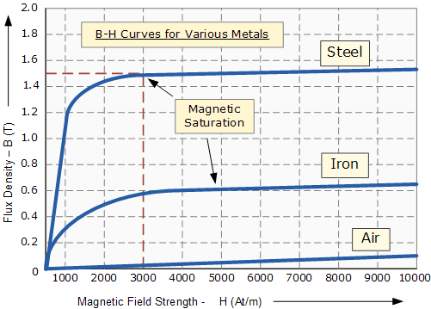
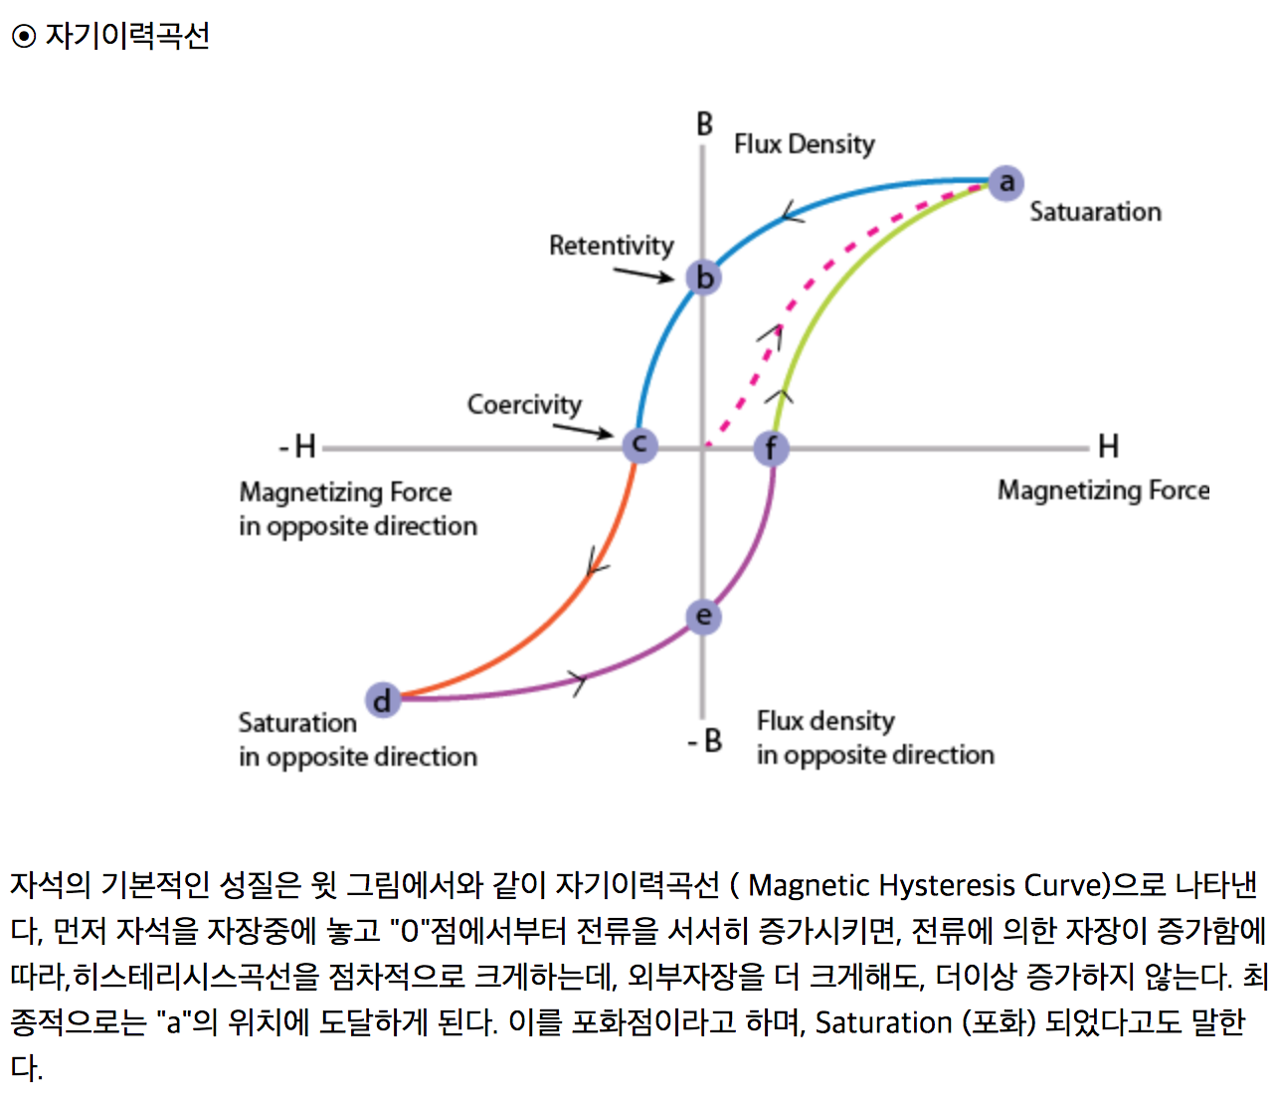
Ferrite Core Memory
(H₀,B₀)
Magnetisation or B-H Curve
(-H₀,-B₀)
Exerted from Wikipedia

Slide 8
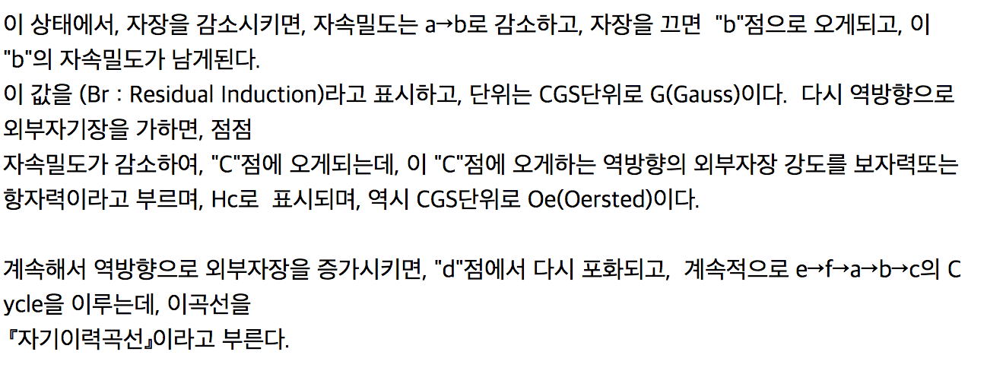
Ferrite Core Memory
Exerted from Wikipedia

Slide 9
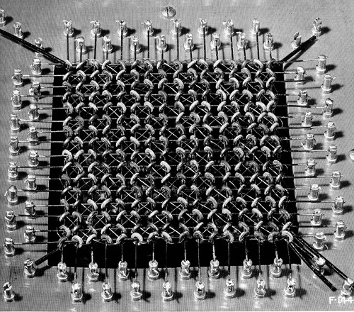
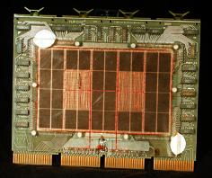
Ferrite Core Stack
16Kword PDP-11
Core Module

Slide 10
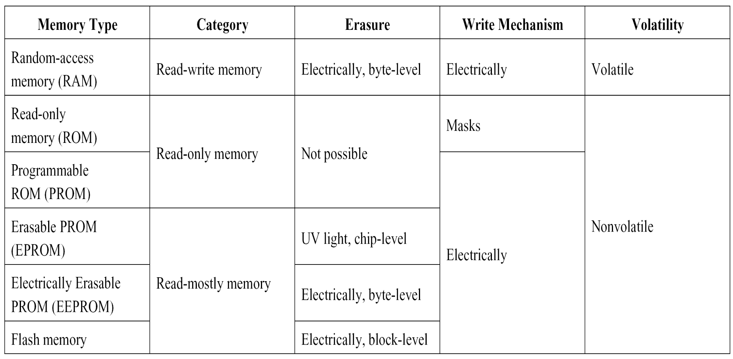
Semiconductor Memory Types

Slide 11
Semiconductor Memory
RAM
  Misnamed as all semiconductor memory is random access
  Read/Write
  Volatile
  Temporary storage
  Static or dynamic

Slide 12
Dynamic RAM
Bits stored as charge in capacitors
  Charges leak
  Need refreshing even when powered
  Need refresh circuits
Simpler construction
  Smaller per bit
  Less expensive
Slower
Main memory
Essentially analogue
  Level of charge determines value

Slide 13
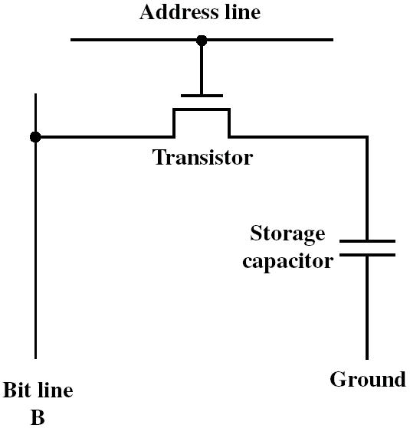
Dynamic RAM Structure
‘High’ Voltage at Y
allows current to flow
from X to Z or Z to X
nMOS
(n-channel MOSFET)
Y
X
Z
one transistor and
one capacitor per bit

Slide 14
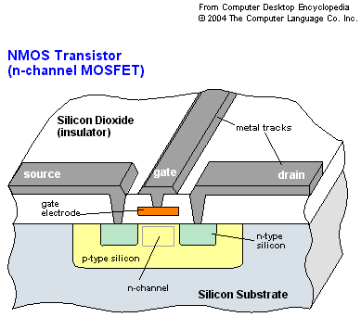
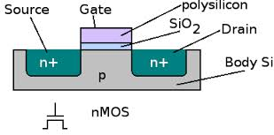
Dynamic RAM Structure
nMOS Transistor
Since the silicon channel b/w the source & drain is of p-type silicon, if a positive voltage is applied to the gate electrode, it will make the n-channel b/w drain and source

Slide 15
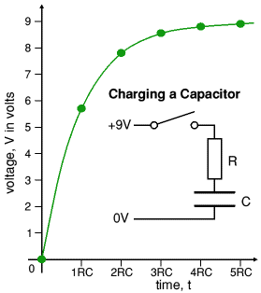
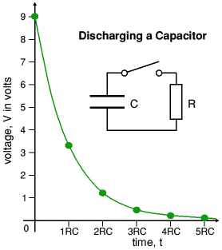
Dynamic RAM Structure
Charging & discharging characteristics of the storage capacitor

Slide 16
Static RAM
SRAM cell is a bi-stable flip-flop
Bits stored as on/off switches
  No charges to leak
  No refreshing needed when powered
  Does not need refresh circuits
More complex construction
  Larger per bit
  More expensive
Faster
Cache
Digital
  Uses flip-flops

Slide 17
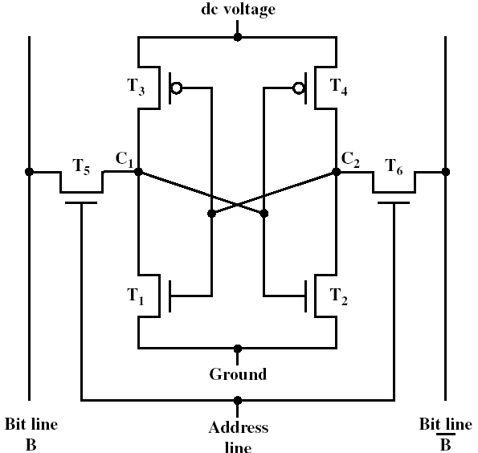
Static RAM Structure
six transistors
per bit
(“flip flop”)
0
1
1
0
(일반적으로 word line이라고 함)

Slide 18
Static RAM Operation
Transistor arrangement gives stable logic state
State 1
  C₁ high, C₂ low
  T₁ T₄ off, T₂ T₃ on
State 0
  C₂ high, C₁ low
  T₂ T₃ off, T₁ T₄ on
Address line transistors T₅ T₆ is switch
Write
  (1) apply value to B & (2) Raise word line (address line)
Read
  (1) value is on line B (2)raise word line

Slide 19
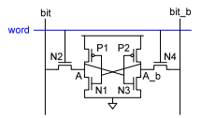
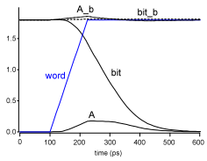
SRAM Read
Precharge both bitlines(bit, bit_b) high
Then turn on word line
One of the two bit lines will be pulled down by the cell
예: A=0, A_b=1 값을 가지고 있다고 가정
bit discharges, bit_b stays high
But A bumps up slightly
Read stability
N1 >> N2 이어야(drive 능력 갖춰야 함)
A=0이므로 bit값을 읽으면 최종 0이됨
아래 그림을 보면,bit, bit_b가모두 1로 되어 있다가 word가 활성화되니(읽고자 하니) A(0)값에 의해 bit이 0이 됨을 알 수 있음

Slide 20
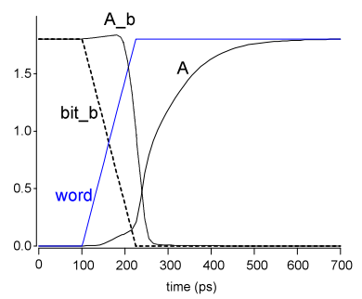
SRAM Write
1
0
Drive one bitline high, the other low
Then turn on word line
Bitlines overpower cell with new value
예: A=0, A_b=1, bit=1, bit_b=0 가정
Turn on word line
From bit(1), bit_b(0), force A to high, A_b to low
Writability
Must overpower feedback inverter
N2 >> P1
0
1
위와 같은 값의 인가로 A의 값이 0→1로 바뀜(write)
A_b는 1→0으로 바뀜(write)

Slide 21
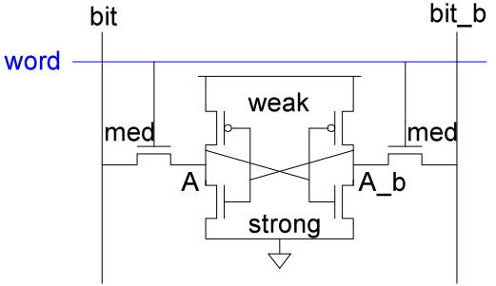
SRAM 크기
High bitlines must not overpower inverters during reads
But low bitlines must write new value into cell
P1
P2
N2
N4
N1
N3
Read stability
N1 >> N2 이어야(drive 능력 갖춰야 함)
Writability
Must overpower feedback inverter
N2 >> P1

Slide 22
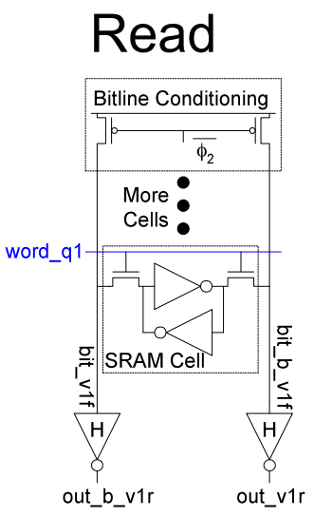
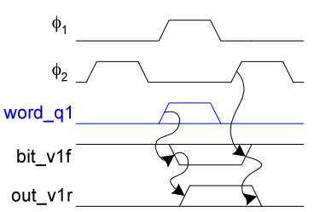
SRAM Column Example(Read 모델)
word_q1 값을 high로해서 SRAM 값을 읽고자 함
Bit_v1f(out_b_v1r)와 bit_b_v1f(out_v1r)값을 얻음

Slide 23
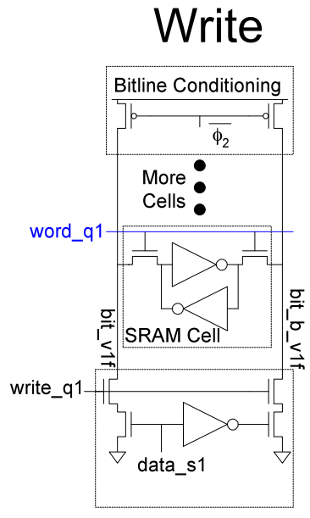
SRAM Column Example( Write 모델)
1. Charging 회로에 의해 bit line에 값이 인가됨
2. Word line을 turn on 함
4. 그림에서 bit_v1f 값은 0→1로, 새로운 값이 쓰여짐
3. Bit line 값에 의해 cell의 값이 overpower 됨

Slide 24
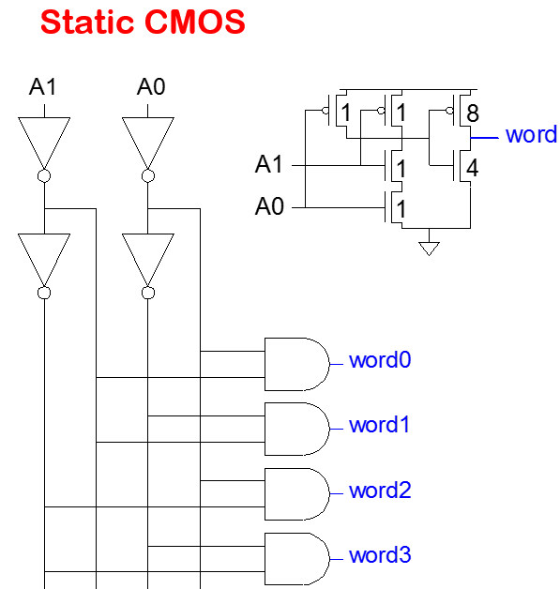
SRAM (Decoder)
n:2^{n} decoder consists of 2^{n} n-input AND gates
  One needed for each row of memory
  Build AND from NAND or NOR gates
If A1A0 =00
If A1A0 =01
If A1A0 =10
If A1A0 =11

Slide 25
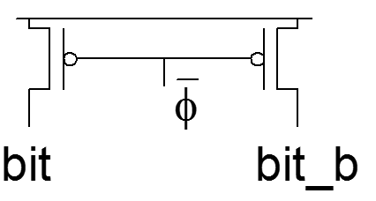
SRAM (Column Circuitry)
SRAM의 Column에는 다음과 같은 회로가 필요함
  Bitline Conditioning
    Precharge bitlines high before reads
    읽기전에 bit line을 precharing함
  Sense Amplifier
    Latch형 혹은 Differential sense amplifier가 존재하며, 신호를 증폭하는 역할을 함
    예를 들어, 메모리 셀로부터 읽은 데이터를 증폭하는 역할수행

Slide 26
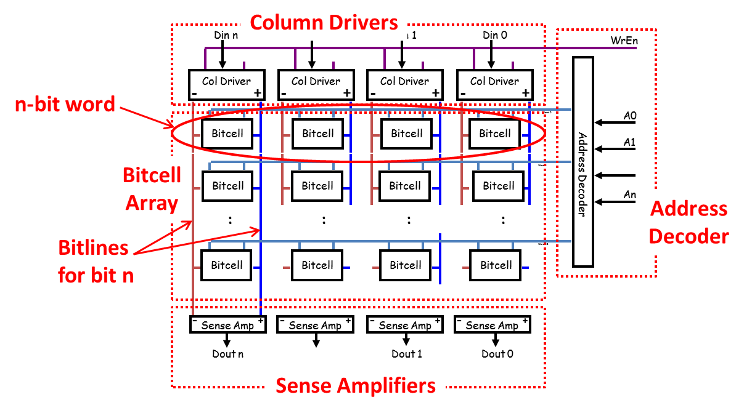
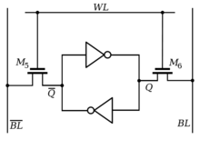
SRAM (Column Circuitry)
구조

Slide 27
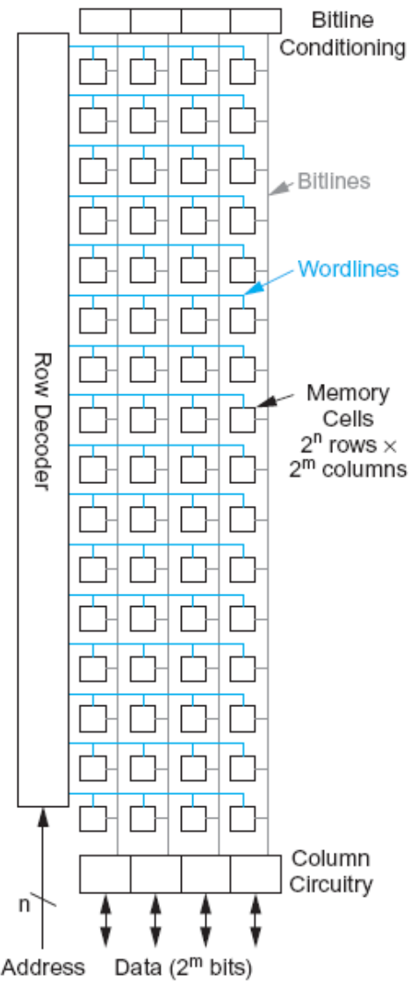
SRAM (Array 구조)
2^{n} words of 2^{m} bits each
  그림에서 column은 총 4개, 즉, 2² bits
  Row는 총 2⁴개(16개),즉 16 words
  여기서 한 word는 4 bits ☺

Slide 28
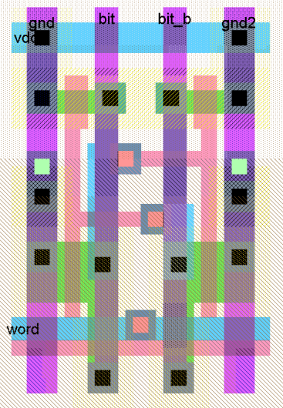
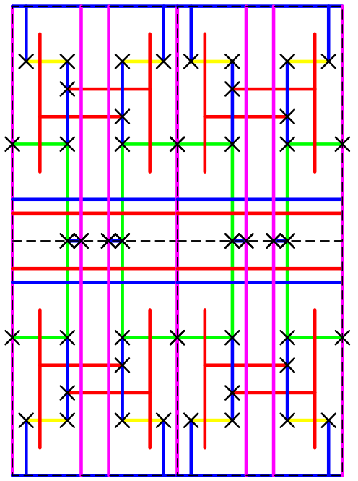
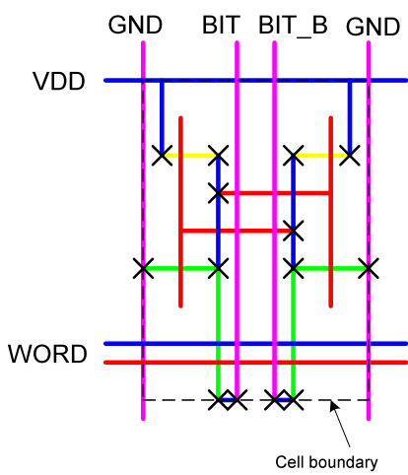
Static RAM Structure
Cell size is critical: 26 x 45 λ (even smaller in industry)
Tile cells sharing VDD, GND, bitline contacts

Slide 29
SRAM v DRAM
Both volatile
  Power needed to preserve data
Dynamic cell
  Simpler to build, smaller
  More dense
  Less expensive
  Needs refresh
  Larger memory units
Static
  Faster
  Cache

Slide 30
Read Only Memory (ROM)
Permanent storage
  Nonvolatile
Microprogramming (see later)
Library subroutines
Systems programs (BIOS)
Function tables

Slide 31
Types of ROM (1)
Mask ROM
  Written during manufacture
  Very expensive for small runs
Programmable (once)
  PROM
  Read-only, write-once
  Needs special equipment to program
Erasable Programmable (EPROM)
  R/W
  Have to erase before write
  Erased by UV

Slide 32
Types of ROM (2)
Electrically Erasable (EEPROM)
  R/W
  Takes much longer to write than read
  Individual bytes programmable
Flash memory
  Can be erased electrically
    In circuit programmability
  Need to be erased and reprogrammed
    Erase whole chip
    Erase block by block
  Programming is different from EPROM
  Reading is same as EPROM/PROM

Slide 33
Organisation in detail
A 16Mbit chip can be organised as 1M of 16 bit words
A bit per chip system has 16 lots of 1Mbit chip with bit 1 of each word in chip 1 and so on
A 16Mbit chip can be organised as a 2048 x 2048 x 4bit array
  Reduces number of address pins
    Multiplex row address and column address
    11 pins to address (2¹¹=2048)
    Adding one more pin doubles range of values so x4 capacity

Slide 34
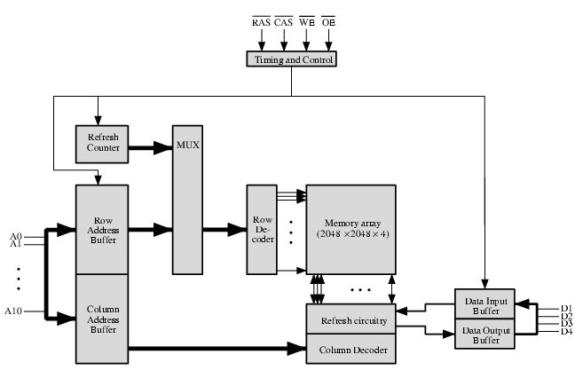
Typical 16 Mb DRAM (4M x 4)
RAS = Row Addr. Select
CAS = Column Addr. Select
WE = Write Enable
OE = Output Enable
a typical organization of a 16-Mbit DRAM.
4 bits are read or written at a time. Logically, the memory array is organized as four square arrays of 2048 by 2048 elements.
2 k x 2 k = 4 M를
4개 사용

Slide 35
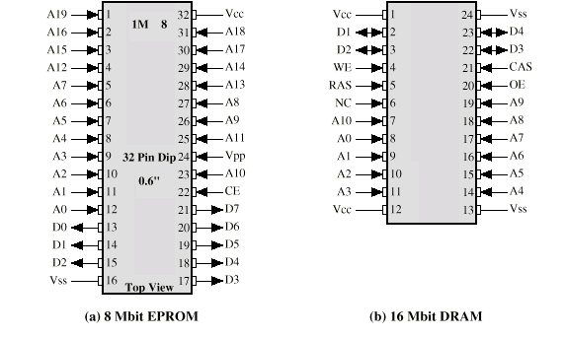
Packaging

Slide 36
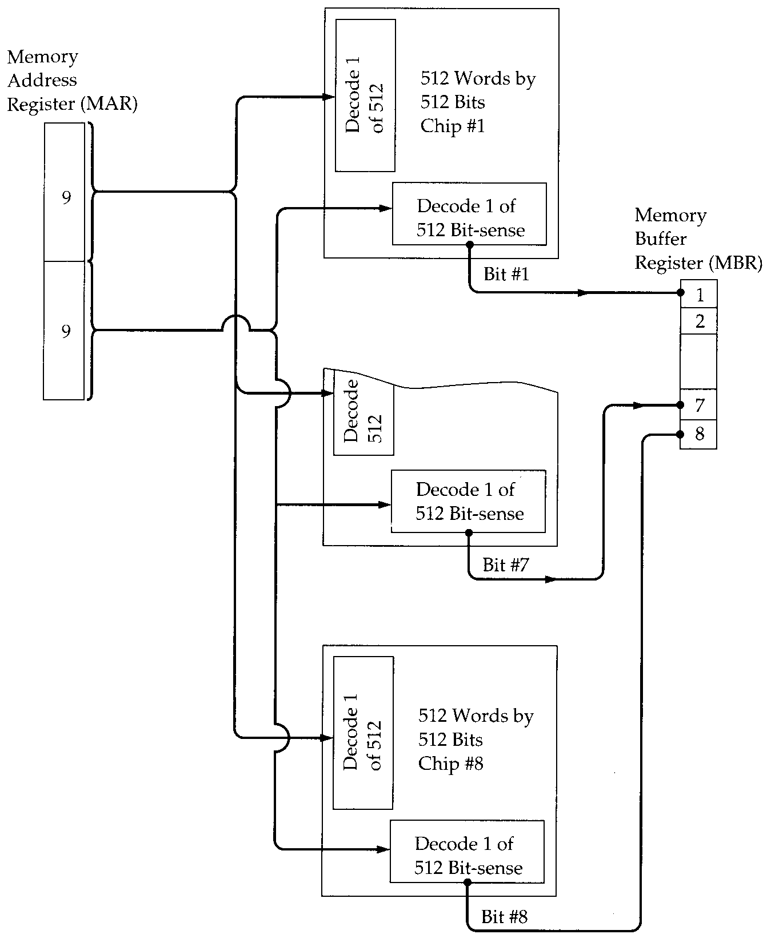
Module
Organization
256K byte
256K = 2¹⁸ = 2⁹ × 2⁹
1 byte = 8 bits
If a RAM chip contains only 1 bit per word, then clearly we will need at least a number of chips equal to the number of bits per word.
This figure shows how a memory module consisting of 256K 8-bit words could be organized.
For 256K words, an 18-bit address is needed and is supplied to the module from some external source (e.g., the address lines of a bus to which the module is attached).
The address is presented to 8 256K * 1-bit chips, each of which provides the input/output of 1 bit.

Slide 37
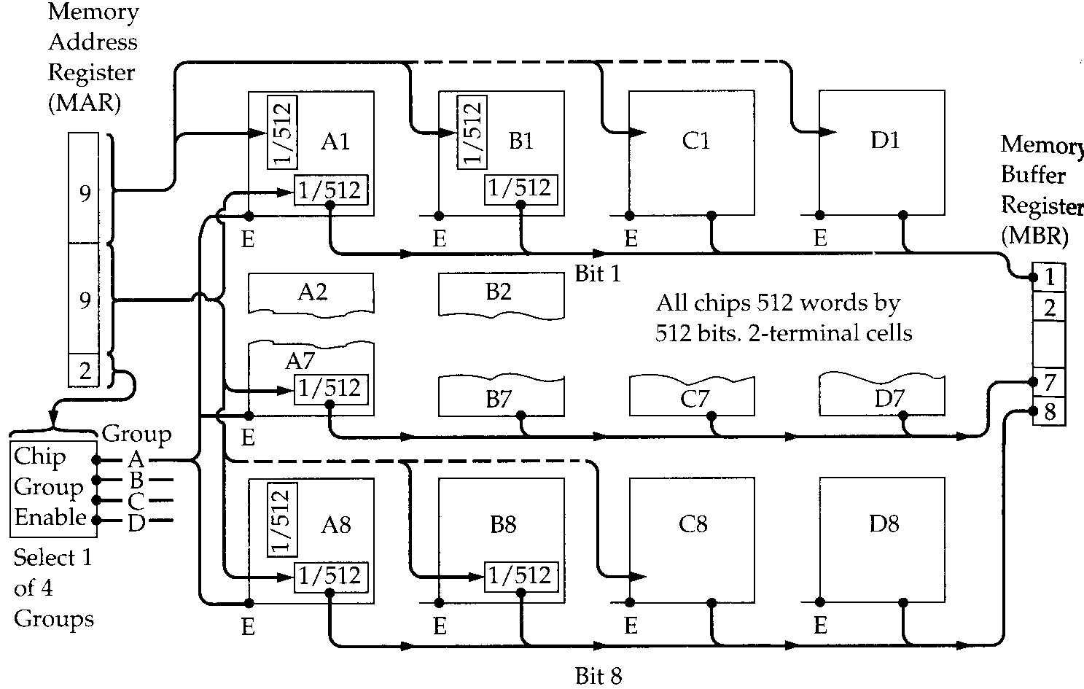
1MByte Module Organization
Groups
A
B
C
D
256 k
256 k
256 k
256 k
4개 256K중에서 하나 선택
Notes:
In the case in which larger memory is required, an array of chips is
needed. Figure 5.6 shows the possible organization of a memory consisting of 1M
word by 8 bits per word. In this case, we have four columns of chips, each column
containing 256K words arranged as in Figure 5.5. For 1M word, 20 address lines are
needed. The 18 least significant bits are routed to all 32 modules. The high-order
2 bits are input to a group select logic module that sends a chip enable signal to one
of the four columns of modules.

Slide 38
Error Correction
Hard Failure
  Permanent defect
Soft Error
  Random, non-destructive
  No permanent damage to memory
Detected using Hamming error correcting code
Logic included to detect/correct errors using Hamming error correcting code
  For an M-bit data,
  M-bit data + K-bit code = (M+K)-bit codeword is stored

Slide 39
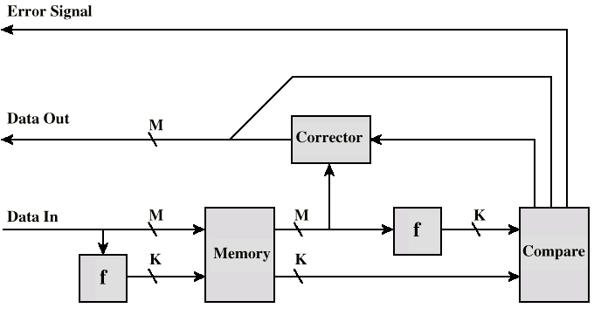
Error Correcting Code Function
Error detected but cannot be corrected
No error
Error detected and
can be corrected

Slide 40
Hamming Code
A
B
A
B
1
1
1
0
1
1
1
0
1
0
0
C
C
Fill the remaining compartments with parity bits.
Make the total number of bit -1 in a circle must be even.
For example: The data bits in A = 1+1+1 = 3. This is odd – therefore add an additional bit -1 to circle A
Assign data bits to the inner compartments.

Slide 41
Hamming Code
A
B
1
1
1
0
C
A
B
A
B
1
1
0
1
1
0
1
1
1
0
0
0
0
0
0
C
C
If a bit gets erroneously changed, the parity bits in that circle will no longer add up to 1.
Errors are found in A and C – and the shared bit in A and C is in error and can be fixed.

Slide 42
Error Correcting and Detecting (1)
code word K는 M+K 길이의
코드 위치를 모두 표현해야 하므로
2^{K}-1 값을 가져야 함
Given an M-bit data is to be stored
  Step 1. Calculate the value for K, the # of code bits
  2^{K} – 1 ≥ M + K
  Step 2. Position M data bits and K code bits in codeword. code bits position number are power of 2
  Step 3. Use even parity to calculate the code bits’ values
How to correct error when a codeword is retrieved
  Step 1. Recalculate code bits’ value
  Step 2. Syndrome = old code bits XOR new code bits
  Step 3. If Syndrome = 0 then no error else Syndrome = error position ➔ flip that bits

Slide 43
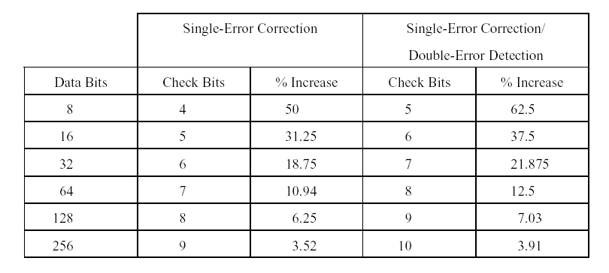
Error Checking Overhead
M K
2^{K}-1 ≥ M + K

Slide 44
Single Bit Errors in 8-bit words
Data and check bits arranged into a 12-bit word.
Bit positions numbered from 1 to 12.
Bit positions representing position numbers that are powers of 2 are designated as check bits.
Check bits calculated as follows:
Data and check bits arranged into a 12 bit syndrome word:
C1 = D1 D2 D4 D5 D7
C2 = D1 D3 D4 D6 D7
C3 = D2 D3 D4 D8
C4 = D5 D6 D7 D8
8
data bits
4
check bits

Slide 45
Calculating check bits
Bit Position | Binary | Type
1 | 0001 | C1 |  | All D’s with a 1 in bit 1
2 | 0010 | C2 |  | All D’s with a 1 in bit 2
3 | 0011 |  | D1
4 | 0100 | C3 |  | All D’s with a 1 in bit 3
5 | 0101 |  | D2
6 | 0110 |  | D3
7 | 0111 |  | D4
8 | 1000 | C4 |  | All D’s with a 1 in bit 4
9 | 1001 |  | D5
10 | 1010 |  | D6
11 | 1011 |  | D7
12 | 1100 |  | D8
C1 = D1 D2 D4 D5 D7
Each check bit works on every data bit who shares the same bit position

Slide 46
Error Correcting and Detecting (2)
Hamming code only correct single error: SEC
Can we also detect 2 errors in addition? SEC-DED
  Include one more bit: p bit
Given an M-bit data is to be stored, add Step 4
  Step 4. Use even parity on all codeword bits to calculate p bit’s values
How to correct/detect error when a codeword is retrieved, modify Step 3
  Step 3. If Syndrome = 0 then no error else Syndrome = error position ➔ flip that bit Recalculate p bit’s value If old p ≠ new p then 2 errors ➔ cannot be corrected

Slide 47
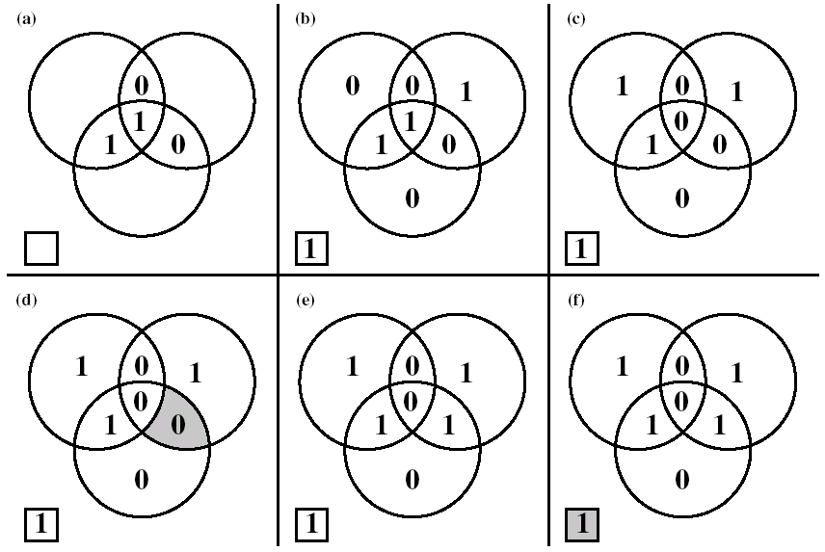
Hamming SEC-DED Code
*
*
The 8th bit that makes total number of 1’s even can detect the occurrence of double bits error
Wrong correction
Wrong detection

Slide 48
Advanced DRAM Organization
Basic DRAM same since first RAM chips
Enhanced DRAM
  Contains small SRAM as well
  SRAM holds last line read (c.f. Cache!)
Cache DRAM
  Larger SRAM component
  Use as cache or serial buffer

Slide 49
Synchronous DRAM (SDRAM)
Access is synchronized with an external clock
Address is presented to RAM
RAM finds data (CPU waits in conventional DRAM)
Since SDRAM moves data in time with system clock, CPU knows when data will be ready
CPU does not have to wait, it can do something else
Burst mode allows SDRAM to set up stream of data and fire it out in block
DDR-SDRAM sends data twice per clock cycle (leading & trailing edge)

Slide 50
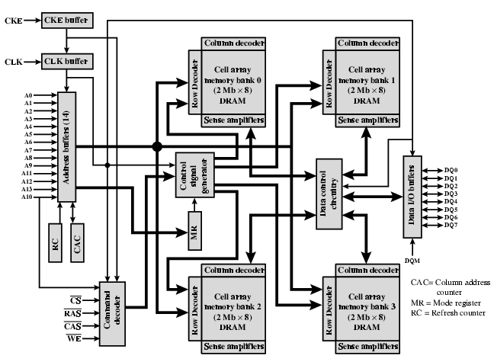
SDRAM

Slide 51
RAMBUS
Adopted by Intel for Pentium & Itanium
Main competitor to SDRAM
Vertical package – all pins on one side
Data exchange over 28 wires < cm long
Bus addresses up to 320 RDRAM chips at 1.6Gbps
Asynchronous block protocol
  480ns access time
  Then 1.6 Gbps

Slide 52
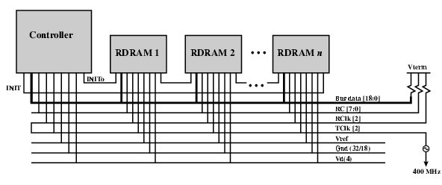
RAMBUS Diagram

Slide 53
DDR SDRAM
SDRAM can only send data once per clock
Double-data-rate SDRAM can send data twice per clock cycle
  Rising edge and falling edge

Slide 54
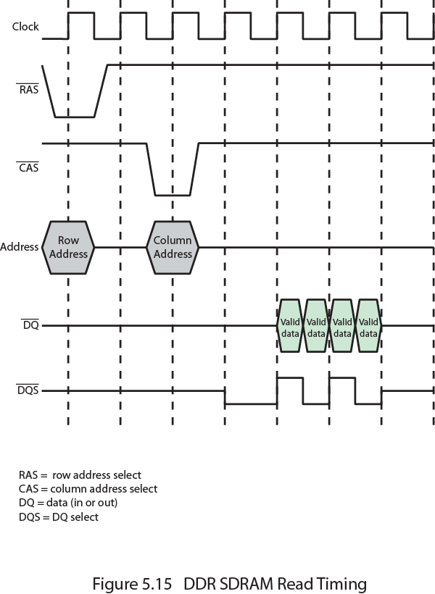
DDR SDRAM
Read Timing

Slide 55
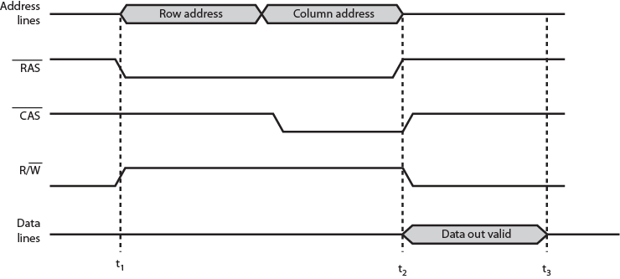
Simplified DRAM Read Timing

Slide 56
Cache DRAM
Mitsubishi
Integrates small SRAM cache (16 kb) onto generic DRAM chip
Used as true cache
  64-bit lines
  Effective for ordinary random access
To support serial access of block of data
  E.g. refresh bit-mapped screen
    CDRAM can prefetch data from DRAM into SRAM buffer
    Subsequent accesses solely to SRAM

Slide 57
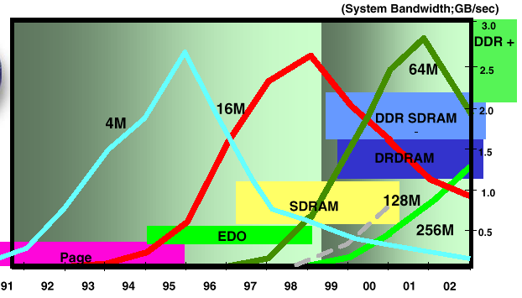
DRAM Technology
Courtesy: Advanced Memory International, Inc.

Slide 58
NOR vs. NAND
FLASH
NOR – Intel in 1988
NAND – Toshiba in 1989
 | NOR | NAND
Capacity | 16bit ~ 1Gbit | 512Mbit ~ 16Gbit
Read Speed | 103MB/s | 18.6MB/s
Write Speed | 0.47MB/s | 2.4MB/s
Erase Time | 900 ms | 2.0 ms
Interface | Full memory interface (Random access) | I/O only (Sequential access)
Ease-of-use | Easy | Complicated
Ideal usage | Code storage and execution (execute in place) | Data storage (program/data mass storage)
Erase cycle limit | 10,000~100,000 | 100,000~1,000,000
Price | High | Low

Slide 59
Flash Memory
Used both for internal memory and external memory applications
First introduced in the mid-1980’s
Is intermediate between EPROM and EEPROM in both cost and functionality
Uses an electrical erasing technology like EEPROM
It is possible to erase just blocks of memory rather than an entire chip
Gets its name because the microchip is organized so that a section of memory cells are erased in a single action
Does not provide byte-level erasure
Uses only one transistor per bit so it achieves the high density of EPROM
Notes:
Another form of semiconductor memory is flash memory. Flash memory is used
both for internal memory and external memory applications. Here, we provide a
technical overview and look at its use for internal memory.
First introduced in the mid-1980s, flash memory is intermediate between
EPROM and EEPROM in both cost and functionality. Like EEPROM, flash memory
uses an electrical erasing technology. An entire flash memory can be erased in
one or a few seconds, which is much faster than EPROM. In addition, it is possible
to erase just blocks of memory rather than an entire chip. Flash memory gets its
name because the microchip is organized so that a section of memory cells are
erased in a single action or "flash." However, flash memory does not provide bytelevel
erasure. Like EPROM, flash memory uses only one transistor per bit, and so
achieves the high density (compared with EEPROM) of EPROM.

Slide 60
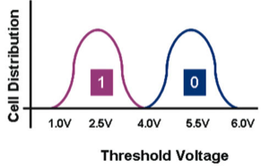
Flash Memory 동작 원리
In a flash memory cell, a second gate—called a floating gate, because it is insulated by a thin oxide layer—is added to the transistor.
State “1”
State “0”
FG에 전자 없는 경우가 “1”
State “1”: program 되지 않음. VT 전압 낮음
State “0”: program 됨. VT 전압 높음
  State “0”에서 Floating gate에 있는 전자가 외부 인가 +를 상쇄시키므로 높은 채널 형성을 위해 더 높은 VT 전압이 필요함
  만약 VT 전압으로 6V 이상을 인가해버리면, state “1”이든 “0”이는 모두 channel이 형성됨
Notes:
Figure 5.15 illustrates the basic operation of a flash memory. For comparison, Figure
5.15a depicts the operation of a transistor. Transistors exploit the properties of
semiconductors so that a small voltage applied to the gate can be used to control the
flow of a large current between the source and the drain.
In a flash memory cell, a second gate—called a floating gate, because it is insulated
by a thin oxide layer—is added to the transistor. Initially, the floating gate
does not interfere with the operation of the transistor (Figure 5.15b). In this state,
the cell is deemed to represent binary 1. Applying a large voltage across the oxide
layer causes electrons to tunnel through it and become trapped on the floating gate,
where they remain even if the power is disconnected (Figure 5.15c). In this state, the
cell is deemed to represent binary 0. The state of the cell can be read by using external
circuitry to test whether the transistor is working or not. Applying a large voltage
in the opposite direction removes the electrons from the floating gate, returning
to a state of binary 1.
An important characteristic of flash memory is that it is persistent memory,
which means that it retains data when there is no power applied to the memory.
Thus, it is useful for secondary (external) storage, and as an alternative to random
access memory in computers.

Slide 61
A single-level NOR flash cell in its default state is logically equivalent to a binary "1" value, because current will flow through the channel under application of an appropriate voltage to the control gate, so that the bitline voltage is pulled down. A NOR flash cell can be programmed, or set to a binary "0" value
어느 Word line 하나라도 ‘1’ 인가하면 Bit line은 ‘0’이 됨(NOR처럼 보임). 모든 word line에 ‘0’일때 Bit line은 ‘1’ → NOR.
Bit line = ~(w1 OR w2 OR … OR w7)
모든 Word line ‘1’ 일때, Bit line은 ‘0’ → NAND.
Bit line = ~(w1 AND w2 AND … AND w7)
NAND flash memory is organized in transistor arrays with 16 or 32 transistors in series. The bit line goes low only if all the transistors in the corresponding word lines are turned on. This is similar in function to a NAND logic gate.
Notes:
There are two distinctive types of flash memory, designated as NOR and NAND
(Figure 5.16). In NOR flash memory , the basic unit of access is a bit, referred to as a
memory cell . Cells in NOR flash are connected in parallel to the bit lines so that each
cell can be read/write/erased individually. If any memory cell of the device is turned
on by the corresponding word line, the bit line goes low. This is similar in function to
a NOR logic gate.
NAND flash memory is organized in transistor arrays with 16 or 32 transistors
in series. The bit line goes low only if all the transistors in the corresponding word
lines are turned on. This is similar in function to a NAND logic gate.

Slide 62
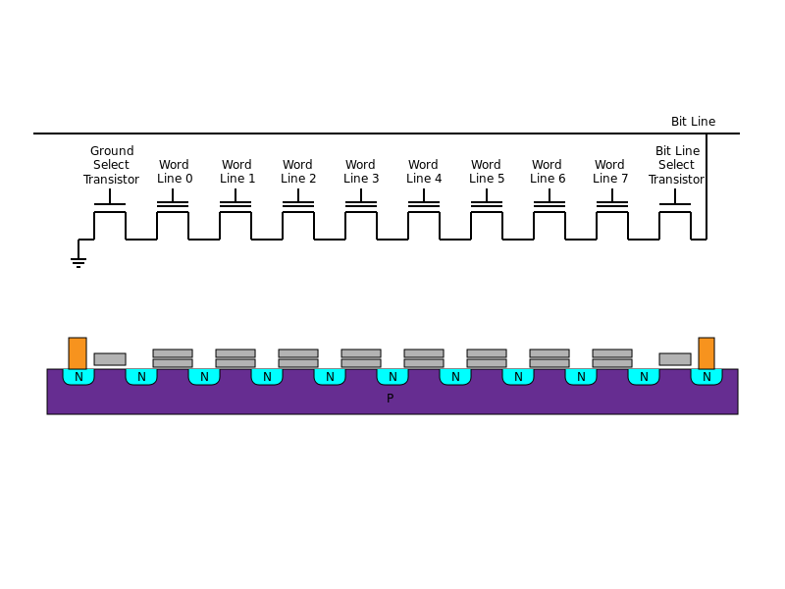
NAND flash data 읽기
NAND의 모든 word lines이 high(트랜지스터 문턱 전압 VT 이상)가 되었을 때, bit line 값이 “0”이 됨 (NAND 로직)
읽기 사례 : word line 4의 값을 읽고자 하는 경우:
word line 4를 제외한 나머지 word line에 높은 VT를 인가함(6V 이상) → 6V 정도에서는 state “1”이든 state “0”이든 모두 CH이 ON이 됨 → word line 4을 읽기 위한 준비 끝~
word line 4에 낮은 VT를 인가함(2.5V)
만약 CH이 ON이 되면, FG에 전자가 없는(program 되지 않은) state “1”이라는 것을 의미함
낮은 VT(2.5V)가 인가된 경우, CH이 ON되지 않으면, state “0”이라는 것을 의미함
* 쓰기는 더욱 단순함: 매우 높은 VT를 인가하면 됨(FG에 전자를 trap하기에 충분한 전압, 예:12V)
Notes:
There are two distinctive types of flash memory, designated as NOR and NAND
(Figure 5.16). In NOR flash memory , the basic unit of access is a bit, referred to as a
memory cell . Cells in NOR flash are connected in parallel to the bit lines so that each
cell can be read/write/erased individually. If any memory cell of the device is turned
on by the corresponding word line, the bit line goes low. This is similar in function to
a NOR logic gate.
NAND flash memory is organized in transistor arrays with 16 or 32 transistors
in series. The bit line goes low only if all the transistors in the corresponding word
lines are turned on. This is similar in function to a NAND logic gate.

Slide 63
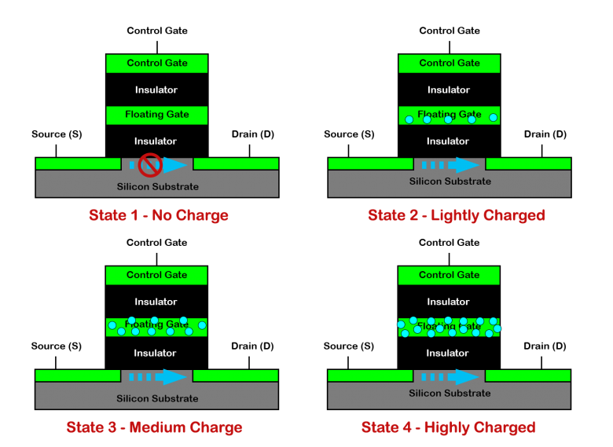
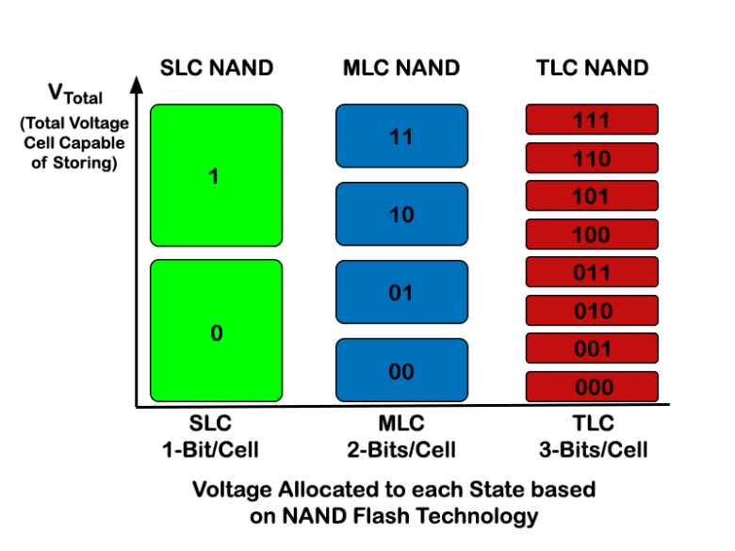
NAND flash – Multilevel Cell
SLC (Single Level Cell)
MLC (Multi Level Cell)
TLC (Tri Level Cell and also known as Triple Level Cell)
https://www.cactus-tech.com/resources/blog/details/solid-state-drive-primer-2-slc-mlc-and-tlc-nand-flash
Notes:
There are two distinctive types of flash memory, designated as NOR and NAND
(Figure 5.16). In NOR flash memory , the basic unit of access is a bit, referred to as a
memory cell . Cells in NOR flash are connected in parallel to the bit lines so that each
cell can be read/write/erased individually. If any memory cell of the device is turned
on by the corresponding word line, the bit line goes low. This is similar in function to
a NOR logic gate.
NAND flash memory is organized in transistor arrays with 16 or 32 transistors
in series. The bit line goes low only if all the transistors in the corresponding word
lines are turned on. This is similar in function to a NAND logic gate.

